Slide 1

PSO program with Matlab
2021/04/14

Slide 2
今日課程內容
介紹內建方程式particleswarm
作業題目講解(refer to PSO_Homework.doc)
利用內建方程式解 PSO Homework
利用m file編程建立PSO演算法

Slide 3
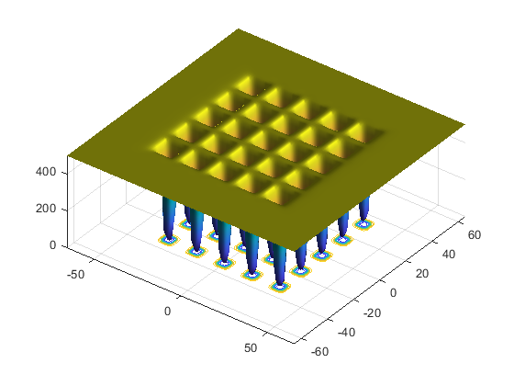
介紹內建方程式 particleswarm
Open file : OptimizeUsingParticleSwarmExample.mlx
This function has 25 local minima.
Try to find the minimum of the function using the default particleswarm settings.
Firstly attempt a default code
Reduce the searching range
Increase the number of particles
Then, confirm again!
Reference:
https://www.mathworks.com/help/gads/optimize-using-particle-swarm-optimization.html
https://www.mathworks.com/help/gads/particleswarm.html

Slide 4
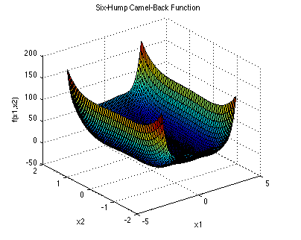


作業題目講解
Open file : PSO Homework.docx
Minimize
x₁ ∈ [-3, 3], x₂ ∈ [-3, 3].
Global Minimum:
https://www.sfu.ca/~ssurjano/optimization.html
Reference:
Molga, M., & Smutnicki, C. Test functions for optimization needs (2005). Retrieved June 2013, from http://www.zsd.ict.pwr.wroc.pl/files/docs/functions.pdf.
4

Slide 5
利用內建方程式解 PSO Homework
Open file : testPSO.m
---A--- Set up scenario
--- B--- PSO function applies
Your tasks:
【1】formulate the problem
【2】define lower bound
【3】define upper bound
【4】number of variables
【5】use function "particleswarm"
【6】output the best result as minFitness
【7】output the position of the best result as minPosition

Slide 6
利用m file編程建立PSO演算法
Steps:
【1】Scenario setup and plot the function
【2】Define parameters
【3】Boundary settings
【4】Initialization
While iterCount < iter
【5】Evaluation
【6】Update pBest and pBest location & Fitness value
【7】Calculation velocities
【8】Update locations
Go to Next Iteration

Slide 7
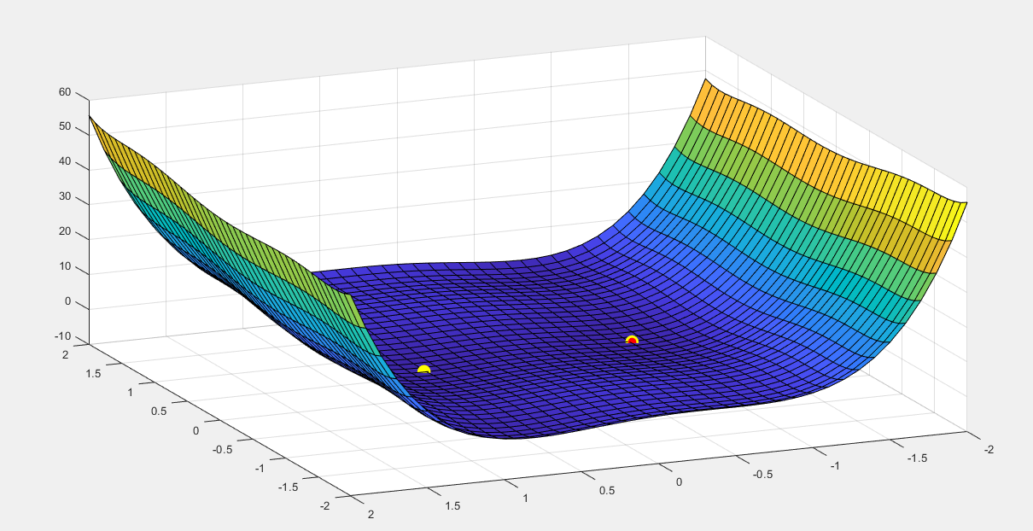
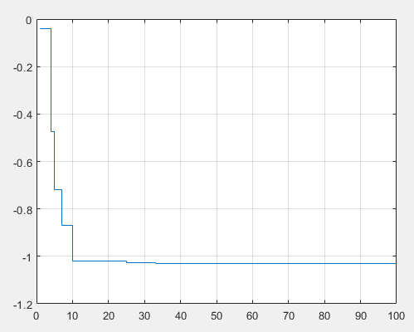
Result
Convergence History

